Slide 1
Interactive Sales Dashboard
Created using Power BI
Dataset: Sales/Financial (Kaggle)

Slide 2
Objective & Tools
Objective:
Design an interactive dashboard to visualize key business metrics.
Tools Used:
power bi
kaggle dataset
metrics: sales, profit, segment performance, regional trends

Slide 3
Dataset Overview
Source: kaggle sales dataset
Fields: order date, sales, profit, region, category, segment
Data cleaning: removed nulls, formatted dates
Feature engineering: month, year extracted from order date

Slide 4
KPIs Explained
Total sales & profit
Sales by region and category
Profit by segment
Time series of sales over time

Slide 5
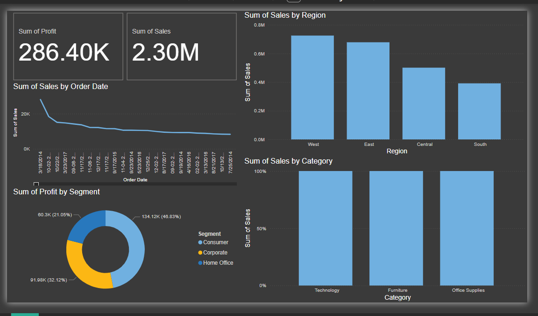
Dashboard Overview

Slide 6
Design & Interactivity
Slicers for date, segment, region
Dark theme for clarity
Cards for sales & profit kpis
Chart types: line, bar, donut

Slide 7
Insights & Recommendations
Highest sales: west region
Most profitable segment: home office
Early sales peaks observed
Recommendations:
Improve south region marketing
Focus on profitable segments

